Slide 1

AirLine Sentiment Data Analysis
Classification Model

Slide 2
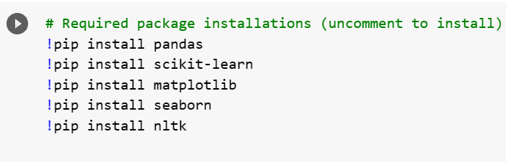
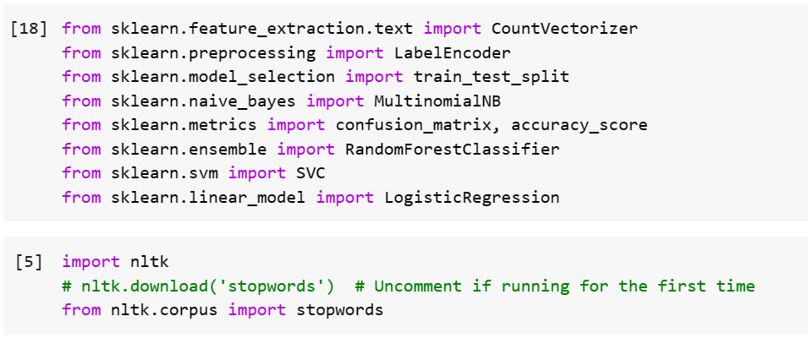
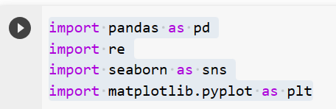
Classification Steps (ML Algorithm)
Install Required Package

Slide 3
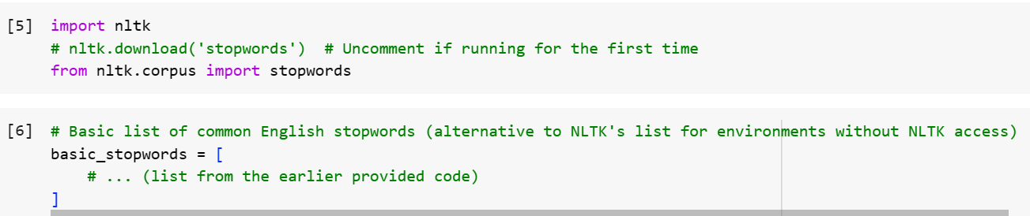
Classification Steps (ML Algorithm)
Install Required Package

Slide 4
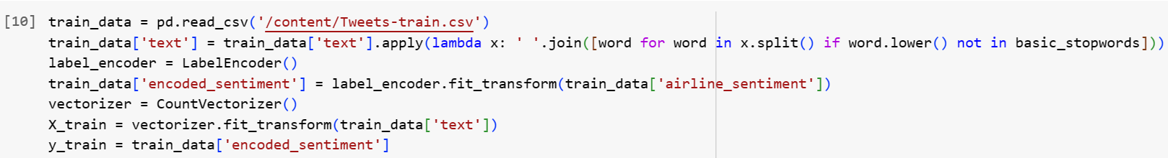
Classification Steps (ML Algorithm)
Train the Data using Count Vectorizer and Label Encoding

Slide 5
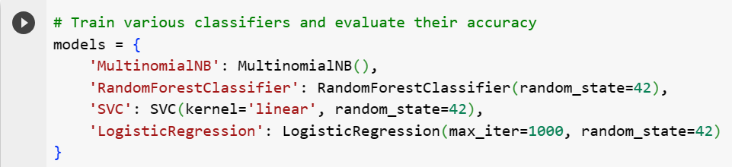
Classification Steps (ML Algorithm)
Initialize the classification models

Slide 6
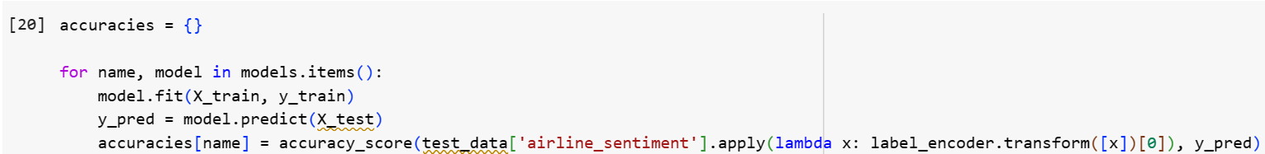
Classification Steps (ML Algorithm)
Train the Model using “Naïve Byes”, “RF Classifier”,"SVC”,”LR”

Slide 7
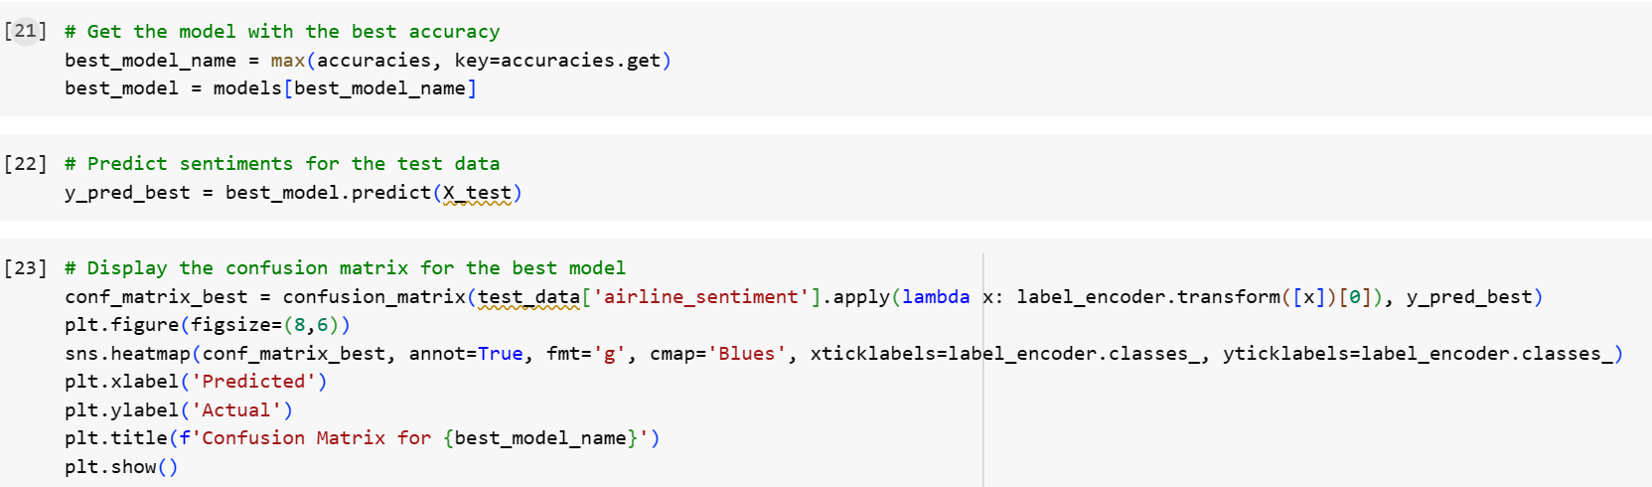
Classification Steps (ML Algorithm)
Predict the Accuracy using “Confusion Matrix”

Slide 8
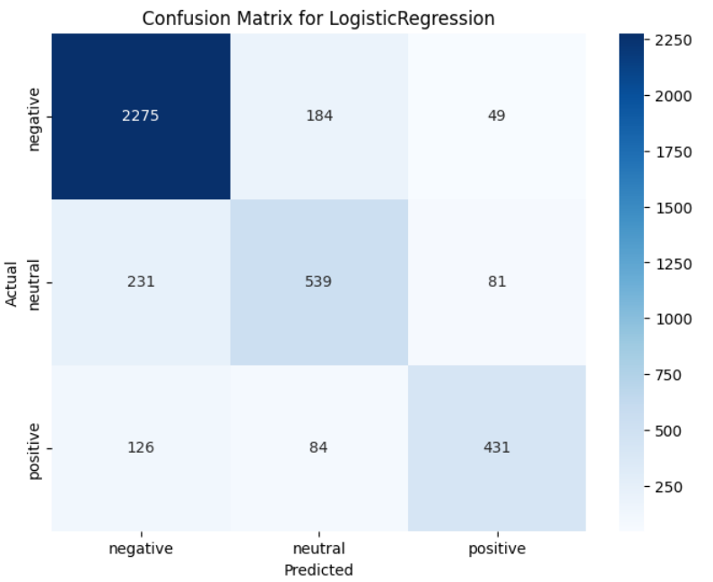
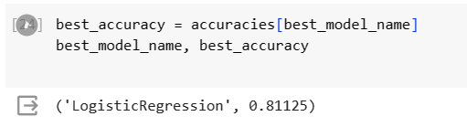
Classification Steps (ML Algorithm)
“Confusion Matrix”
Logistic Regression provides
The Best Accuracy of
81%

Slide 9
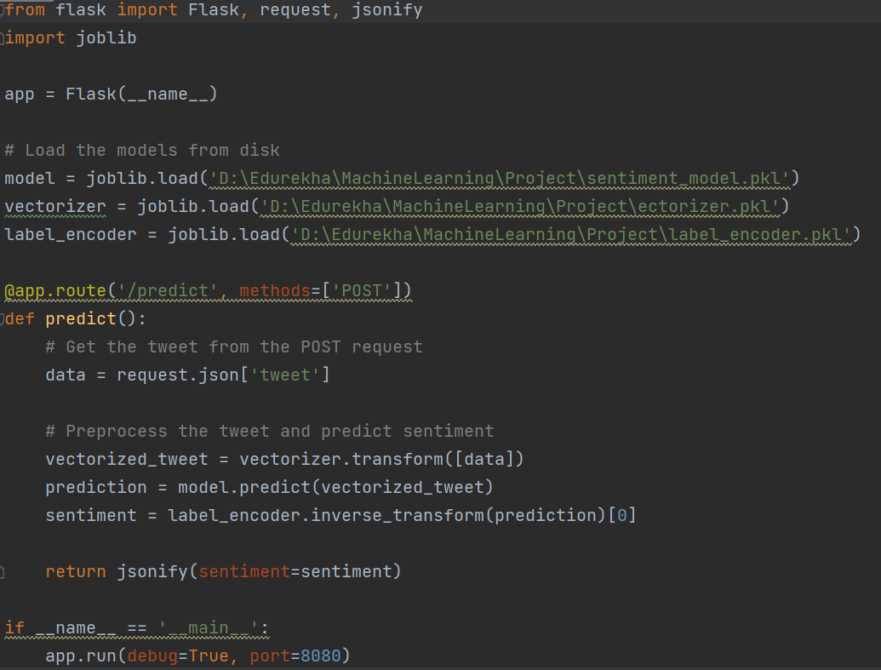
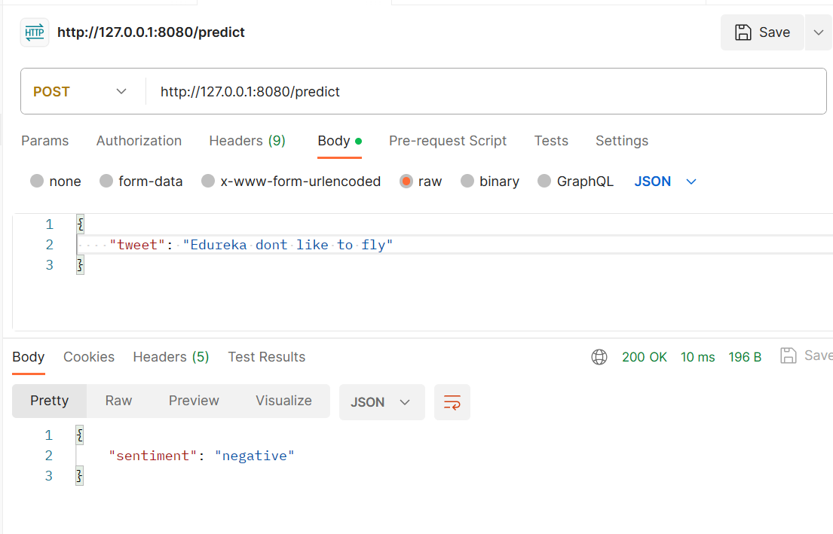
Model Deployment

